Slide 1


DIGITAL PORTFOLIO
NAME:
D.HEMACHANDRU
REG NO:
2428A0018
NMID:
ASBRU262428A0018
DEPARTMENT:
BSC.DIGITAL AND CYBER FORENSICS SCIENCE
COLLEGE:
SHRI NEHRU MAHA VIDYALAYA COLLEGE OF ARTS AND SCIENCE

Slide 2


PROJECT TITLE
PERSONAL PORTFOLIO WEBSITE

Slide 3
AGENDA
1.PROBLEM STATEMENT
2.PROJECT OVERVIEW
3.END USERS
4.TOOLS AND TECHNOLOGIES
5.PORTFOLIO DESIGN AND LAYOUT
6.FEATURES AND FUNCTIONALITY
7.RESULTS AND SCREENSHOTS
8.CONCLUSION
9.GITHUB LINK

Slide 4

PROBLEM STATEMENT
IN THE MODERN DIGITAL ERA, RELYING ONLY ON TRADITIONAL
RESUMES IS NOT ENOUGH TO SHOWCASE AN INDIVIDUAL’S
SKILLS, PROJECTS, AND ACHIEVEMENTS. RECRUITERS AND
COLLABORATORS OFTEN LOOK FOR AN ONLINE PRESENCE
THAT REFLECTS BOTH TECHNICAL EXPERTISE AND
CREATIVITY. WITHOUT A PERSONAL DIGITAL SPACE, IT
BECOMES DIFFICULT TO STAND OUT IN A COMPETITIVE
FIELD. TO OVERCOME THIS CHALLENGE, THIS PROJECT
FOCUSES ON DEVELOPING A PERSONAL PORTFOLIO
WEBSITE , PROVIDING AN ORGANIZED AND PROFESSIONAL
PLATFORM TO PRESENT QUALIFICATIONS, CERTIFICATIONS,
AND PROJECTS IN AN EASILY ACCESSIBLE MANNER.

Slide 5

PROJECT OVERVIEW
THE PERSONAL PORTFOLIO WEBSITE IS DEVELOPED FOR HEMACHANDRU
TO BUILD A STRONG ONLINE PRESENCE AND SHOWCASE
ACADEMIC QUALIFICATIONS, TECHNICAL SKILLS, CERTIFICATIONS, AND
PROJECTS. IT ACTS AS A DIGITAL RESUME THAT IS EASILY ACCESSIBLE
AND HELPS RECRUITERS AND COLLABORATORS UNDERSTAND
PROFESSIONAL ABILITIES AT A GLANCE. DESIGNED WITH A
RESPONSIVE LAYOUT, THE PORTFOLIO ENSURES SMOOTH VIEWING
ACROSS DEVICES WHILE PRESENTING INFORMATION IN A CLEAR AND
ORGANIZED MANNER.

Slide 6


WHO ARE THE END USERS?
RECRUITERS AND
EMPLOYERS – TO
EVALUATE SKILLS,
QUALIFICATIONS, AND
PROJECTS FOR JOB
OPPORTUNITIES.
PEERS AND
COLLABORATORS – TO
CONNECT FOR ACADEMIC
OR PROFESSIONAL
PROJECTS.
FACULTY MEMBERS AND
EVALUATORS – TO ASSESS
TECHNICAL KNOWLEDGE
AND PROJECT WORK.
GENERAL AUDIENCE –
ANYONE INTERESTED IN
LEARNING MORE ABOUT
THE PROFESSIONAL PROFILE
OF ALMAS BEGAM

Slide 7

TOOLS AND TECHNIQUES
FRONTEND DEVELOPMENT:
HTML5 – FOR STRUCTURING THE WEB PAGES.
CSS3 – FOR STYLING AND LAYOUT DESIGN.
JAVASCRIPT – FOR INTERACTIVITY AND DYNAMIC BEHAVIOR.
VERSION CONTROL & HOSTING:
GIT & GITHUB – FOR VERSION CONTROL AND PROJECT HOSTING.
DESIGN TOOLS:
CANVA / FIGMA – FOR CREATING AND REFINING UI/UX DESIGNS.
TECHNIQUES:
RESPONSIVE WEB DESIGN – ENSURING COMPATIBILITY ACROSS DEVICES.
USER-CENTERED DESIGN – FOCUSING ON READABILITY, ACCESSIBILITY, AND PROFESSIONAL
PRESENTATION.
CODE OPTIMIZATION – CLEAN, REUSABLE, AND WELL-STRUCTURED CODE FOR PERFORMANCE

Slide 8

PORTFOLIO DESIGN AND LAYOUT
THE PORTFOLIO WEBSITE IS DESIGNED WITH A
CLEAN AND MODERN LAYOUT TO ENSURE
PROFESSIONALISM AND USER-FRIENDLY
NAVIGATION. THE DESIGN FOLLOWS A
RESPONSIVE WEB STRUCTURE, MAKING IT
ACCESSIBLE ACROSS DESKTOPS, TABLETS,
AND MOBILE DEVICES.
HOME PAGE – A BRIEF INTRODUCTION WITH NAME, TITLE, AND A PROFESSIONAL
TAGLINE.
ABOUT ME – SHOWCASING PERSONAL BACKGROUND, EDUCATION, AND CAREER
GOALS.
SKILLS – HIGHLIGHTING TECHNICAL AND SOFT SKILLS IN AN ORGANIZED FORMAT.
PROJECTS – DISPLAYING ACADEMIC AND PERSONAL PROJECTS WITH
DESCRIPTIONS.
CERTIFICATIONS – LISTING RELEVANT CERTIFICATIONS AND ACHIEVEMENTS.
CONTACT SECTION – PROVIDING EMAIL, PHONE, AND SOCIAL MEDIA LINKS FOR
EASY COMMUNICATION

Slide 9

FEATURES AND FUNCTIONALITIES
RESPONSIVE DESIGN – WORKS SMOOTHLY ON DESKTOP, TABLET, AND MOBILE.
HOME & ABOUT SECTIONS – INTRODUCTION, BACKGROUND, AND CAREER GOALS.
SKILLS & PROJECTS – SHOWCASES TECHNICAL ABILITIES AND ACADEMIC WORK.
CERTIFICATIONS – DISPLAYS COMPLETED CERTIFICATIONS AND ACHIEVEMENTS.
CONTACT SECTION – PROVIDES EMAIL, PHONE, AND SOCIAL MEDIA LINKS.
EASY NAVIGATION – CLEAN AND USER-FRIENDLY MENU SYSTEM.

Slide 10

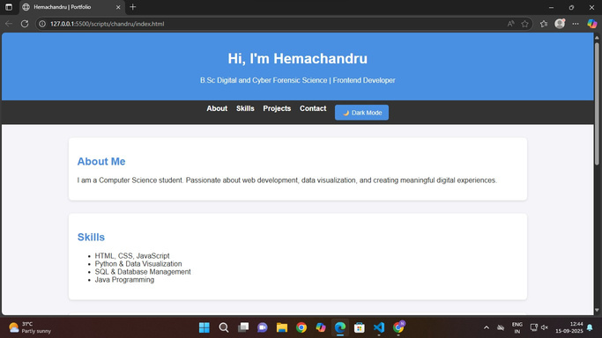
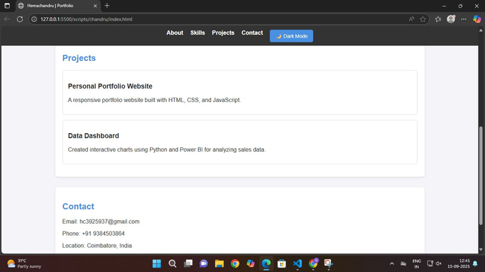
RESULTS AND SCREENSHOTS
THE PORTFOLIO WEBSITE EFFECTIVELY HIGHLIGHTS MY SKILLS, EDUCATION, PROJECTS, AND
ACHIEVEMENTS IN A STRUCTURED MANNER. IT PROVIDES RECRUITERS AND PEERS WITH EASY
ACCESS TO MY PROFESSIONAL DETAILS, IMPROVING VISIBILITY AND NETWORKING OPPORTUNITIES.
THE RESPONSIVE DESIGN ENSURES A SMOOTH VIEWING EXPERIENCE ACROSS DEVICES, MAKING
THE PORTFOLIO BOTH PRACTICAL AND IMPACTFUL.

Slide 11

CONCLUSION
THE PERSONAL PORTFOLIO WEBSITE SUCCESSFULLY PROVIDES A PROFESSIONAL PLATFORM FOR HEMACHANDRU TO SHOWCASE ACADEMIC ACHIEVEMENTS, TECHNICAL SKILLS, CERTIFICATIONS, AND PROJECTS IN AN ORGANIZED MANNER. IT SERVES AS A DIGITAL RESUME, ENHANCING VISIBILITY AND ACCESSIBILITY FOR RECRUITERS, PEERS, AND COLLABORATORS. WITH ITS RESPONSIVE DESIGN AND USER FRIENDLY LAYOUT, THE PORTFOLIO STRENGTHENS PERSONAL BRANDING AND SUPPORTS FUTURE CAREER OPPORTUNITIES.

Slide 12

THANK YOU

